Slide 1
Manage Operations
The Tire and Rubber Association of Canada Kicks Off 2021 With A New Website!
Notes:
Title page
Share the name of the presentation or resource

Slide 2
Carol Hochu
President and CEO, MBA, CAE
Tire and Rubber Association of Canada
chochu@tracanada.ca

Slide 3
Goal: Development of a new Association website that combines industry and consumer initiatives under one central domain, www.tracanada.ca

Slide 4
The Need
Separate websites with distinct domains created confusion for internal & external stakeholders (i.e. consumers and industry).
We were not identifying as the Association, with these separate websites.
The consumer facing sites (www.betiresmart.ca and www.fuelsavingtires.ca) and main Association website (www.tracanada.ca) created disassociation between websites and lacked Association credibility.
Separate websites resulted in separate identities i.e. no one knew that www.betiresmart.ca and www.fuelsavingtires.ca were the consumer facing website of www.tracanada.ca
Management of these various websites was taxing and drained internal resources to keep both websites up-to-date/current.
While developing the new site, TRAC also decided to optimize its technology services related to web hosting and management. The existing services were distributed between several providers making it difficult to track services, customer support and billing (The challenge was to continue to have fully operational site at all times while changing hosting providers).
Notes:
Purpose: Share the situation before building your solution.
Outcome: A one or two-sentence description that explains the need your association faced.
Format: Use a maximum of 3 bullet points to describe what was happening and the impact on the association and their members.
E.g. Our community wants to share their experience and knowledge, but the process of sharing the information is cumbersome and complex.
The community didn't use existing resources to their maximum potential.
Using multiple platforms created internal and external confusion.

Slide 5
Previous Attempts
We tried to cross reference our websites where possible to build the relationship between them to allow for consumers to make the association to TRAC through:
- Social media
- Website
- Email
- Awareness campaigns
- Newsletter
Notes:
Purpose: Share what solutions/ fixes you tried before this solution.
Outcome: Bulleted list of tools, template, processes or procedures
Format: Use a maximum of 5 bullets to list what you already tried.
E.g. We've tried using
Pheeploop
Website
Association Connect
Emails
Manual processes.

Slide 6
Process
Worked with the Board to obtain project buy-in.
Created strategy and developed the project scope and requirements.
Created needs analysis and documented.
Reviewed the traffic to various websites.
Analyzed the content within each website.
Looked at other Association websites to assess further direction.
Sought input from Association membership.
Strategized amongst web developer and Association staff to determine how best to combine and present the information to ensure industry stakeholders and consumers found with ease information specific to their needs ease.
Created a plan with milestones and timelines.
Executed the plan.
Notes:
Purpose: Share the steps you/your team took to build arrive at the solution.
Outcome: Brief description of the steps you took towards solving your problem.
Format: Use a maximum of 500 characters to describe the process. If possible, keep the description too short sentences, one sentence per bullet point.
E.g.
Reviewed our submission processes.
Ran interviews with staff and stakeholders to identify the challenges and opportunities.
Reviewed quantitative and qualitative data from the community surveys.
Reviewed other similar associations' resource tools and submission processes.
Classified our needs and goals.
Eliminated solutions that wouldn't work.
Created an implementation plan, we all agreed on.

Slide 7
Investment
Human Resources
Financial Resources
Team/Total time spent:
Web Developer: Strategy Cube
Michal Majernik, TRAC’s Manager of Communications, served as Project Mgr.
Staff input provided by the Executive Assistant, Director of Operations and President/CEO
Outreach to members
Total project took approximately 8 months
Website development $17,000
French Translation $1,795
Notes:
Purpose: Explain which human and financial resources were allocated to building the resource.
Outcome: Describe what it took for the resource to be build include:
A list of human resources and a role they played.
Total Time Spent, and
The total budget allocated to developing the solution.
Format: Bulleted list
E.g.
Team/ Total time spent
Danielle, Sponsor
Claudette, Designer
Eve, Project Manager
Casey, Developer
Emma, Developer
Vasan, Data Analyst
Penny, Marketing
Time Spent: 93 hours
Financial investment: $9,635

Slide 8
Learnings: What went well
What went exceptionally well was how we determined the look and feel of the website. The web developer created several templates that looked cohesive and could be used interchangeably to create distinct pages that flowed together.
Using our trademark red and white colours, the new templates allowed for images and text boxes of varying sizes that resulted in interesting and eye-catching pages where information could be presented.
The content organization and amalgamation for both, industry and consumer audiences presented a significant challenge, but the new site clearly distinguishes between industry and consumer information.
Notes:
Purpose: Share your learnings from the experience
Outcome: Brief explanation that answers:
What's one thing that went exceptionally well during the project that we can repeat in the future?
What's one thing that went wrong, and how could it be avoided in the future?
What's one thing we could do differently next time?
Format: Use a maximum of 300 characters to answer each question (one per slide)
E.g.
Well - We discussed issues frequently and resolved them quickly to meet the needs of the membership and staff.

Slide 9
Learnings: What went wrong
Our launch timeline was delayed due to the added decision to include and allow for French translation. Decisions were required to determine what portions of the website would be translated as many of our information bulletins were from external sources and the cost of translation of this information was not in the original budget.
Notes:
E.G. Wrong - We didn't find the "best" way to do things; we only found the most convenient.

Slide 10
Learnings: Next time?
As a whole, the project went quite smoothly. Our only stumbling block was the decision to include some French translation. As a website that provides users with information, not all content is unique to the Association. We rely on bulletins and information sources that are not available in French and English.
French translation of such external documents would not have been cost-effective or even accurate given the technical nature of some of the content.
Notes:
E.G. Different - Don't jump to solutions before determining what the real problem is. Use a human performance improvement system to assess the entire situation.

Slide 11
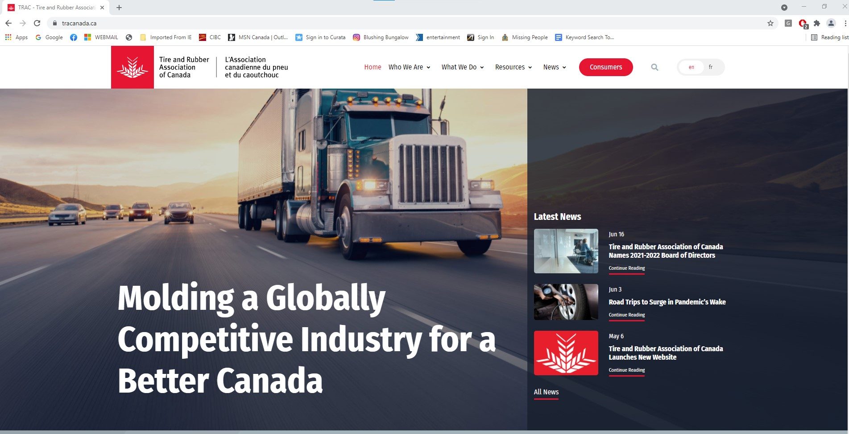
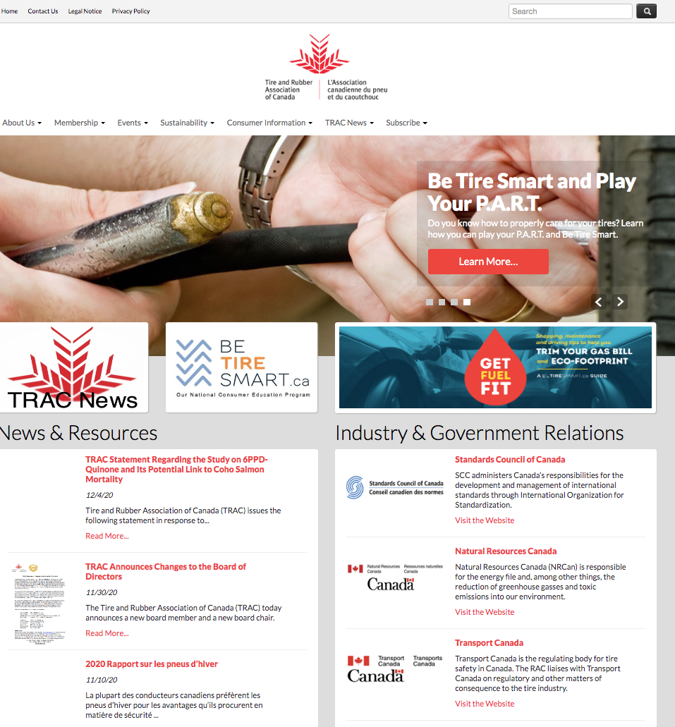
Benefits and Outcomes
Our goal to bring all our web assets, www.betiresmart.ca, www.fuelsavingtires.ca, and www.tracananda.ca together was achieved.
As a WordPress site, we are able to easily add content as it becomes available, keeping the website fresh and up-to-date.
Content is well organized and visitors are able to seek out industry and consumer information easily and quickly. The “Consumer” button is distinct, allowing for easy site navigation.
TRAC’s website technology services have been organized under single provider with ease of use, service, and more favorable cost.
French translation for much of the website
Before: After:
Notes:
Purpose: Explain the potential or actual results and benefits of using the resource.
Outcome: The community will understand the potential or actual results gained by using your resource.
Format: Use a maximum of 300 characters to describe the benefit you expect or have already achieved.
E.g.
By implementing the submission guide and updating our processes, we reduced the member submission time by 15%. The number of submitted resources increased by 18% per month. Administration time decreased by 28%

Slide 12
Next Steps:
The new website was launched in May 2021 with the support of a Press Release to industry and stakeholders (https://tracanada.ca/news/tire-and-rubber-association-of-canada-launches-new-website/). The launch was covered by trade press (https://www.tirebusiness.com/news/trac-launches-redesigned-website) and positively received by members and other stakeholders.
The URL www.tracanada.ca has been used to direct traffic from social media campaigns to the new website where visitors can explore information.
We have committed to directing visitors to the website through our newsletter, social and additional marketing initiatives.
Notes:
Purpose: Explain how to use the resource.
Outcome: The community will have a course of action to implement the same day and the following week. Also, a tip on a potential obstacle and workaround they may face when using the resource.
Format: Use a maximum of 300 characters to explain the next steps.
E.g.
Your next steps for getting the most out of the Submission guide is to:
immediately create a user login online at www.csae.com/resourcesubmission
The next activity is to create the one-sentence statement
A challenge when working with the tool is to get caught by semantics i.e., Analysis paralysis. To avoid that, limit the amount of time you can spend developing your one-sentence statement to 2 hours maximum.

Slide 13
Thank you,
If you have questions, contact us at: chochu@tracanada.ca
1-647-606-6833

